Slide 1
Music Suggestions
Unsupervised Learning Capstone Project
Michelle Thorne

Slide 2
Overview
Introduction
Research Question
The Data
Modeling
Results and Recommendations

Slide 3


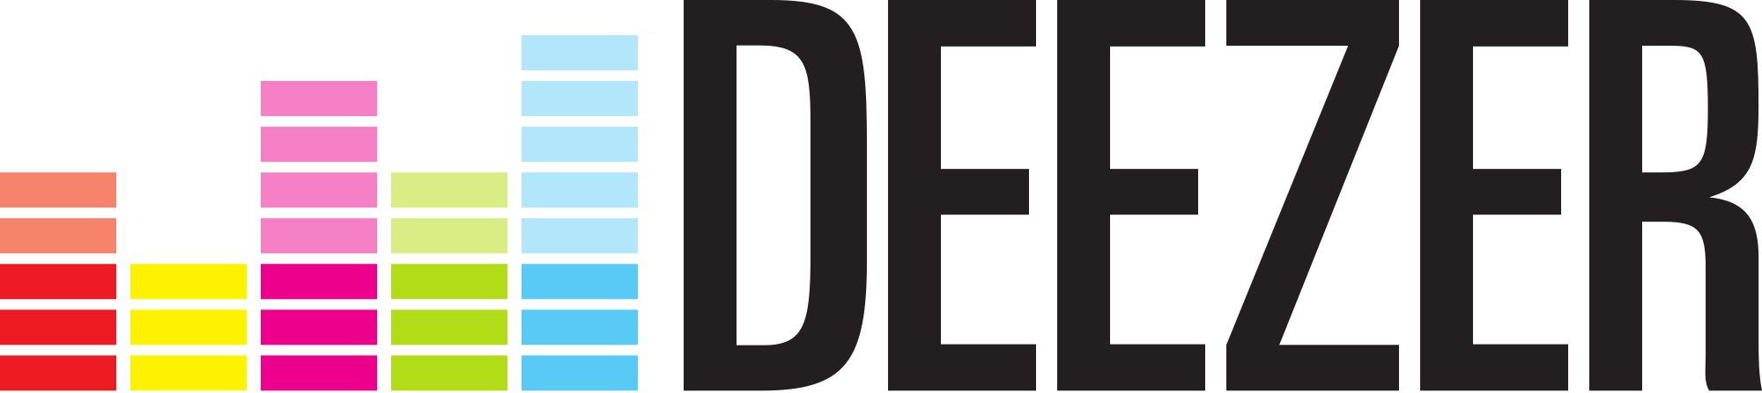





Introduction
Music streaming services have been around for 20 years.
Napster - 1999
Pandora (US) - 2000
Deezer (France) - 2007
SoundCloud(Germany)-2007
Amazon Prime Music (US) - 2007
Spotify (Sweden) - 2008
Tidal (Norway) - 2014
Apple Music (US) - 2015

Slide 4

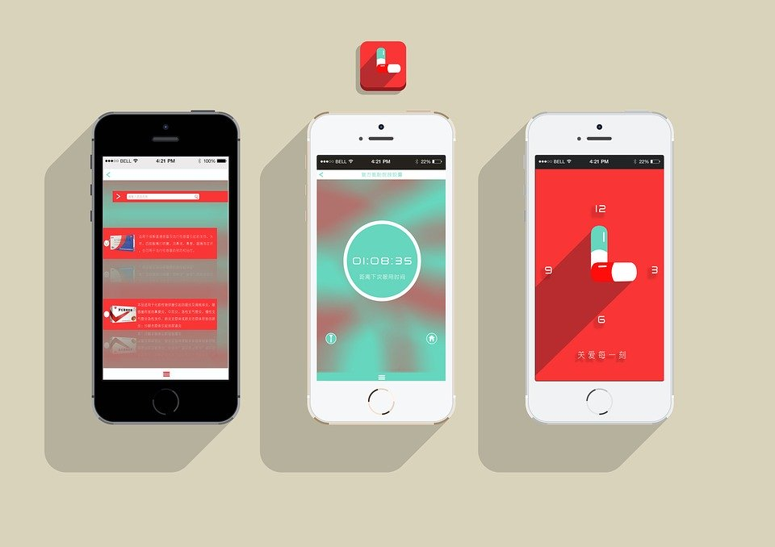


How to remain competitive?
Price
App features
“Music lockers”
User interface
Playlist and sharing capabilities
Size of music library
Song recommendation algorithms
User behavior based - Pandora
Song similarity algorithms - Spotify

Slide 5
Research Question
How does Spotify analyze songs and use it to make meaningful recommendations to users?

Slide 6
The Data

Slide 7
The Data
Open source dataset from Kaggle: Spotify dataset 1921-2020
data.csv
Organized by tracks (169,000+)
Contains 13+ attributes or features for each track
data_w_genres.
Organized by artist
Listed multiple genres for each artist
Final modeling data was reduced to 38,000 tracks using popularity (>50)

Slide 8
data.csv
169,909 rows x 19 columns
Columns:
Artists
Name
ID
Release_date
Year
Duration_ms
Acousticness (0.0-1.0)
Danceability (0.0-1.0)
Energy (0.0-1.0)
Explicit (0-No, 1-Yes)
Instrumentalness (0.0-1.0)
Key (0-11: C-0, C#-1…)
Liveness (0.0-1.0)
Loudness (0.0-1.0)
Mode (0-Minor, 1-Major)
Popularity (0-100)
Speechiness (0.0-1.0)
Tempo (50-150 BPM)
Valence (0.0-1.0)

Slide 9
data_w_genres.csv
27,621 rows x 16 columns
Columns:
Artists
Duration_ms
Genres
Acousticness (0.0-1.0)
Danceability (0.0-1.0)
Energy (0.0-1.0)
Instrumentalness (0.0-1.0)
Key (0-11: C-0, C#-1…)
Liveness (0.0-1.0)
Loudness (0.0-1.0)
Mode (0-Minor, 1-Major)
Popularity (0-100)
Speechiness (0.0-1.0)
Tempo (50-150 BPM)
Valence (0.0-1.0)

Slide 10
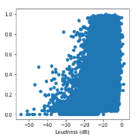
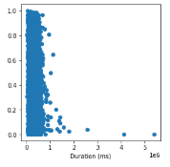
The Data
Most songs rank high in loudness
Most songs are 2-3 min long

Slide 11
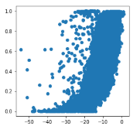
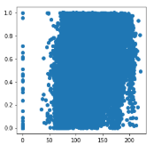
The Data
Loudness and energy are highly correlated
Higher tempos indicates higher energy

Slide 12
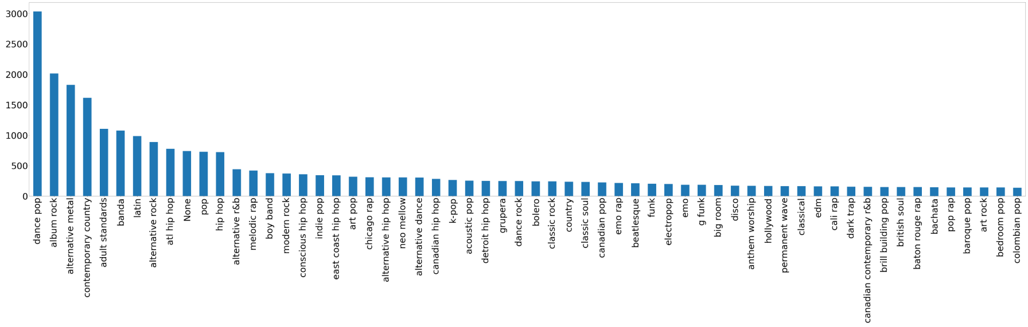
The Data

Slide 13
Modeling

Slide 14


Dimensionality Reduction
Dummy variables were used for text based data and PCA was used to reduce them.
Artists Genres

Slide 15

Dimensionality Reduction
Results were combined in a new dataframe with the numeric data and UMAP was run to reduce its dimensions

Slide 16
Modeling: K-Means
K-Means was run using several different values for number of clusters (5-200)
Number of clusters chosen was 4000 despite the silhouette scores (-0.4616)
Number of observations in each cluster ranged from 1 to 41.
Popularity was used as a weight.

Slide 17
Modeling: Mini Batch
Once 4000 clusters was found using K-Means, I used that parameter for Mini Batch as well.
Popularity was again used as a weight.
The silhouette score was .2498
The number of clusters found was 3,833.
Number of observations in each cluster ranged from 1 to 45
Recommendation lists were very similar and consistent with K-Means

Slide 18
Modeling: HDBSCAN
Parameters for HDBSCAN included:
Min_cluster_size = 2
Cluster_selection_method = ‘leaf’
metric=’euclidean’
Found 5957 clusters with maximum of 21 tracks in any one cluster.
13,304 observations were labeled as noise.
Gave a silhouette score of 0.4217

Slide 19
Results

Slide 20
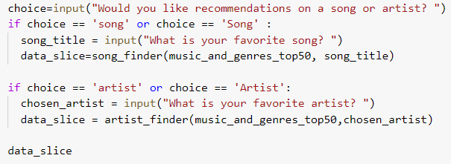
User Input

Slide 21
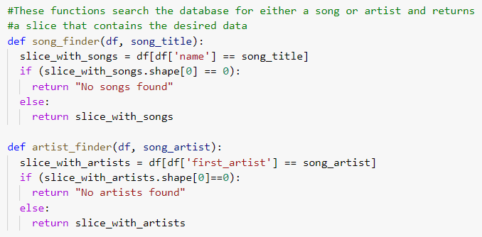
Functions

Slide 22
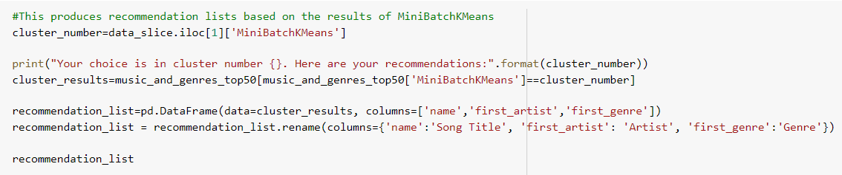
Output

Slide 23
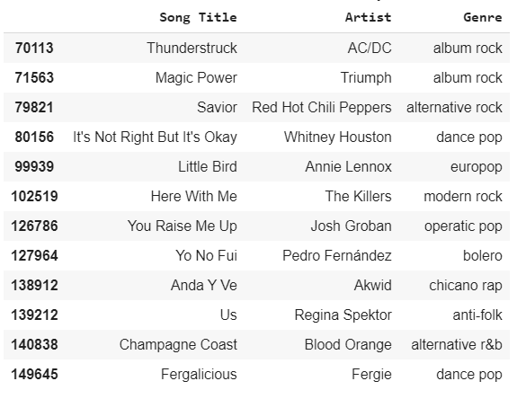
Josh Groban “You Raise Me Up” - K-Means

Slide 24
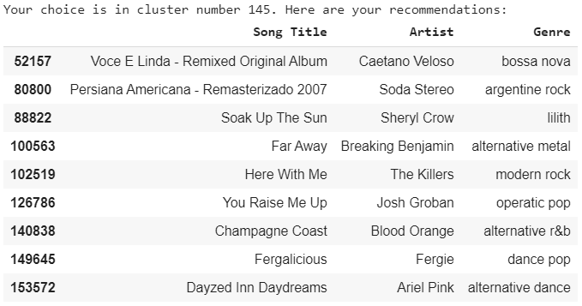
Josh Groban “You Raise Me Up” - MiniBatch

Slide 25
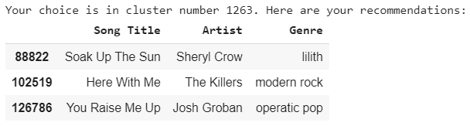
Josh Groban “You Raise Me Up” - HDBSCAN

Slide 26
Recommendations

Slide 27
Recommendations
Improvements:
Incorporate better filtering for results instead of:
Taking the first item in the slice for the cluster number
Using a random sampling of the cluster
Importance and Applications:
Competitive features (Spotify, Netflix)
Marketing (Amazon, ads on internet based on recent Google searches etc)

Slide 28
Questions?
Thanks for watching!

